Slide 1

Principles of Program Design: Problem Solving with JavaScript
Chapter 10
Arrays

Slide 2
Objectives
In this chapter, you learn to:
Define an array and describe how to create one
Describe how to load an array directly and interactively
Explain how a For loop can be used to traverse an array
Explain how to search an array sequentially for a specified value

Slide 3
Objectives (cont’d.)
Explain how to improve the efficiency of a search
Write a binary search algorithm
Define parallel arrays and how they’re used
Define multidimensional arrays and describe how to code them

Slide 4
Introduction
Information processing
  Can involve hundreds or thousands of data items
If data is used only once:
  Can use same variable name for each new piece of input data
If information needs to be retained:
  Need separate variable name for each piece of data
Arrays handle large number of similar variables

Slide 5
What Is an Array?
Array
  A collection of elements
Elements
  Set of variables with the same data type
Subscripts
  Distinguish elements from one another
  Usually enclosed in square brackets
  Follow array name
  Sequential whole numbers starting with zero

Slide 6

What Is an Array? (cont’d.)
Array declarations
  Data type
  Size
  Example:
  Doesn’t necessarily set values
Loading arrays directly or interactively
  Initialize with default value
  Or load with desired values
  Some languages automatically initialize:
    Numeric variables to 0 and string variables to NULL

Slide 7
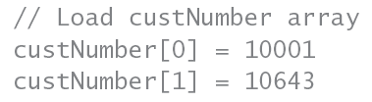

What Is an Array? (cont’d.)
Loaded arrays said to be populated
Example: load five customer numbers in custNumber array

Slide 8
What Is an Array? (cont’d.)
Arrays can be loaded in declaration statement
If array size is not declared explicitly:
  Size equals number of values assigned
Loading arrays interactively with For loops
  Loop counter can be used as array subscript
  Using a constant for array size is recommended
    Easier to modify later
  Examples on next slide

Slide 9
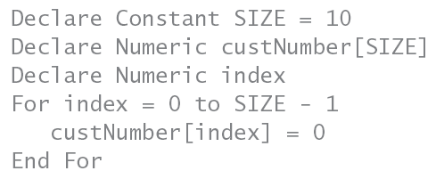
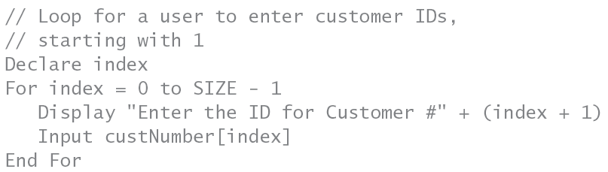

Slide 10
What Is an Array? (cont’d.)
Don’t have to fill entire array with data
  Initialize array to default value
  Add new customer numbers
    Start at beginning of array
    Look for first default value and enter new number there
  Example on next slide

Slide 11
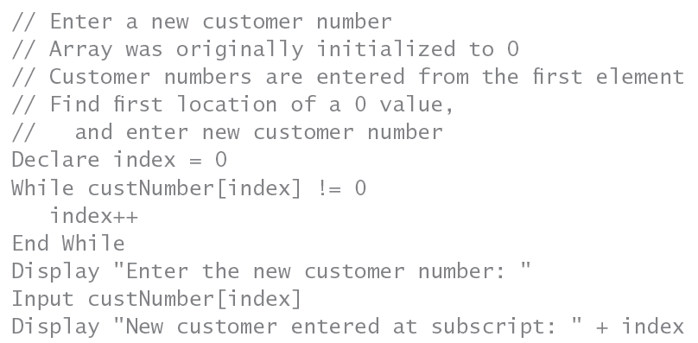
What Is an Array? (cont’d.)

Slide 12
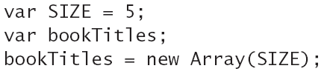
Arrays in JavaScript
JavaScript arrays
  Instantiated with keyword new
  Argument sent in parentheses
  Examples:

Slide 13
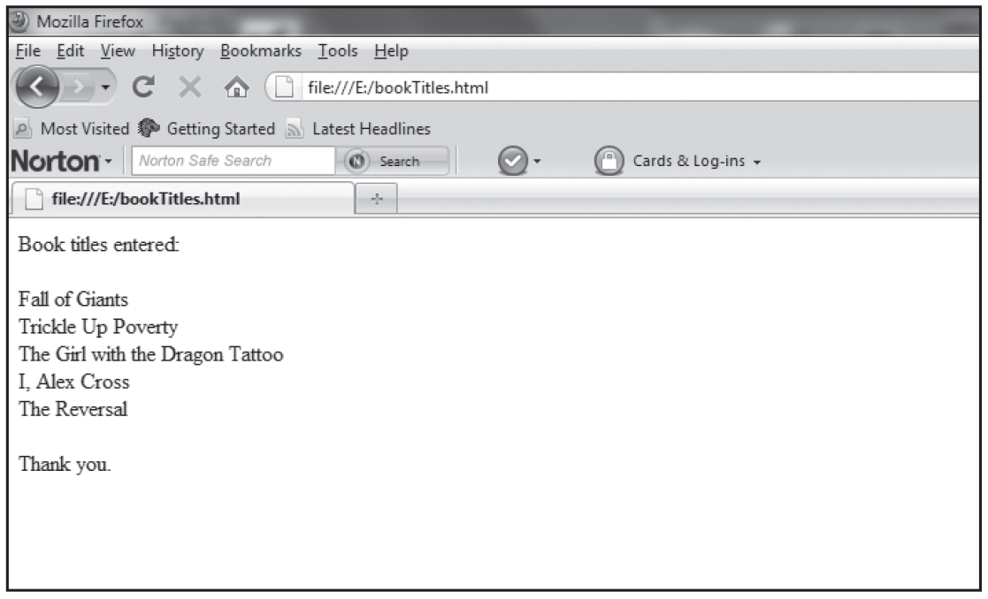
Arrays in JavaScript (cont’d.)
Create Program 10-1 on pages 381-382
Figure 10-1 The bookTitles.html program in a Web browser

Slide 14
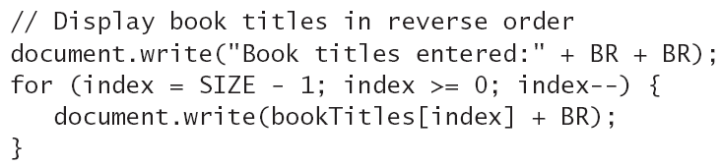
Arrays in JavaScript (cont’d.)
To access all array elements:
  Traverse it from lowest subscript to highest
    Use a For loop ranging from zero to SIZE-1
  Or traverse it backward
    Start loop with highest subscript
    Subtract 1 from index each time through the loop

Slide 15
Arrays in JavaScript (cont’d.)
Shorthand notation: incrementing and decrementing
  To increment variable num by 1
    Use num++
  To decrement by 1
    Use num--
  Or to increment or decrement by 5
    Use += or -= operator
    Examples: num +=5, num -=5

Slide 16
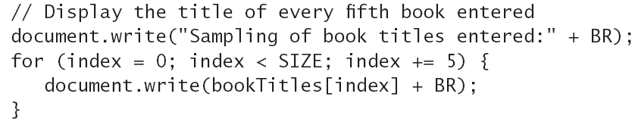
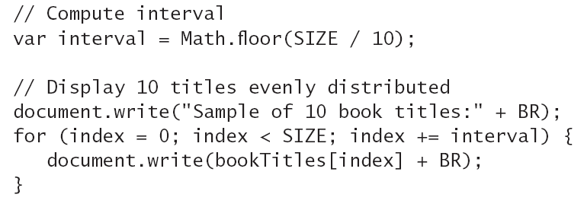

Slide 17
Searching Arrays
Sequential searches
  Simplest search algorithm
  Start at beginning of array
  Compare each element’s value:
    To one you’re trying to match
Can use a Boolean value called found
  To indicate whether a match has been found
  Initialize to False and set to True if match found

Slide 18
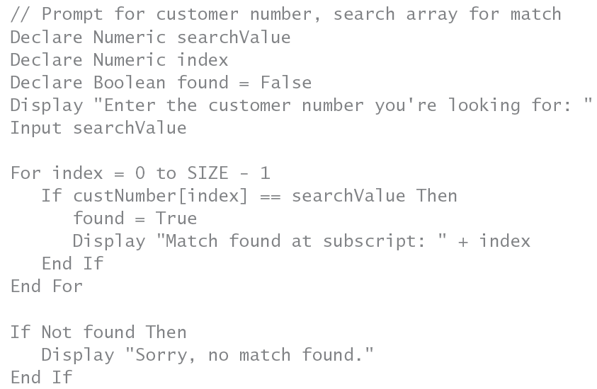

Slide 19
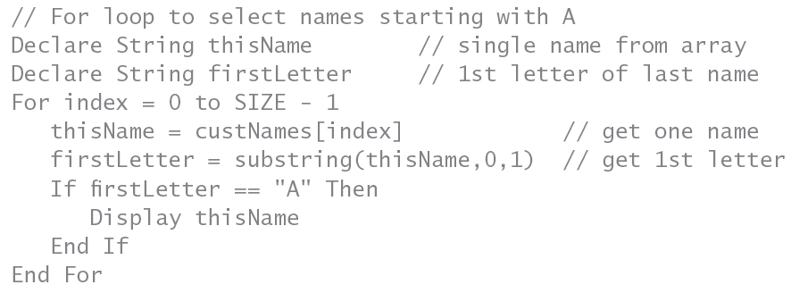
Searching Arrays (cont’d.)
Example: searching for multiple matches
  Customers whose last name begins with “A”

Slide 20
Searching Arrays (cont’d.)
Improving search efficiency
  Exit the loop after match has been found
    If you need to find only one match
Limitation of the For loop
  Designed for counter-controlled loops
  One condition determines when to quit
  Difficult to use multiple conditions
    While loop is clearer

Slide 21
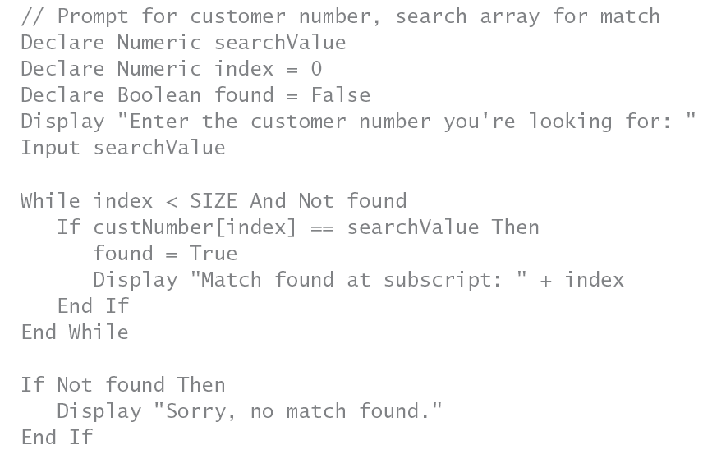

Slide 22
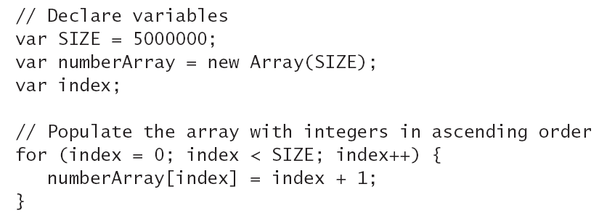
Searching Arrays (cont’d.)
With sorted arrays and a single target match
  Sequential searches are inefficient
Add a variable to track number of comparisons
  Allows you to determine algorithm’s efficiency
Example: creating a sorted array

Slide 23
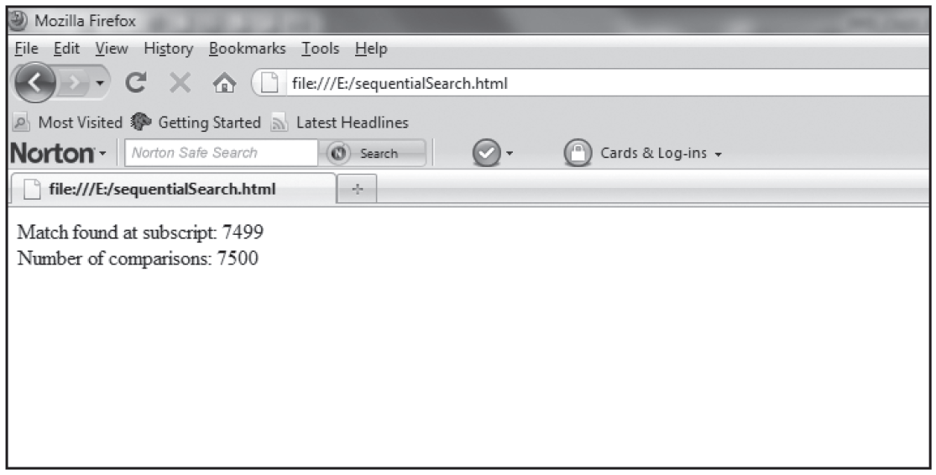
Searching Arrays (cont’d.)
Create sequential search algorithm in JavaScript
  Problem defined on page 387
  Example solution:
Figure 10-2 The sequentialSearch.html program in a Web browser

Slide 24
Searching Arrays (cont’d.)
Binary searches
  More efficient than sequential searches on large arrays
  Array must be sorted for binary search to work
  Checks whether search value is higher or lower than array element
    Adjusts search area with each comparison
  Uses low and high pointers
    Midpoint determined and compared with search value

Slide 25
Searching Arrays (cont’d.)
Example: searching for 1375 in array of size 2001
  Array contains numbers equal to subscripts
  Algorithm on next two slides

Slide 26
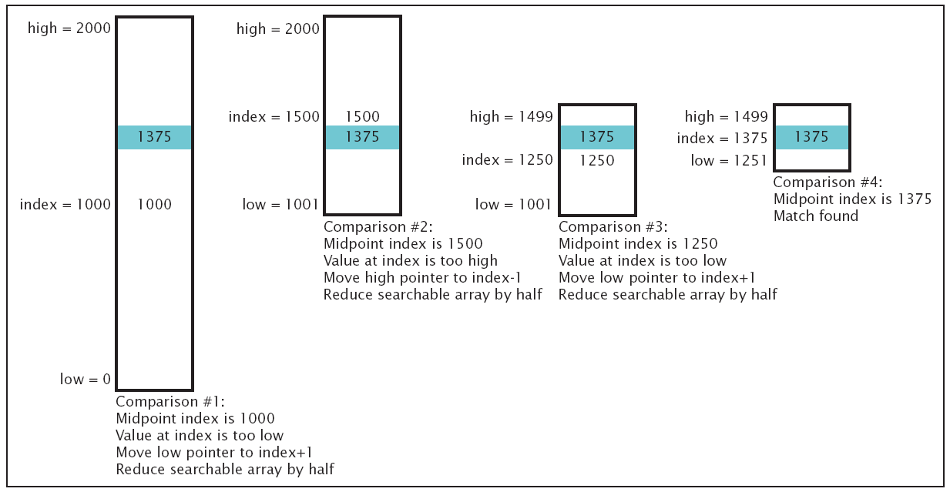
Figure 10-3 The binary search algorithm

Slide 27
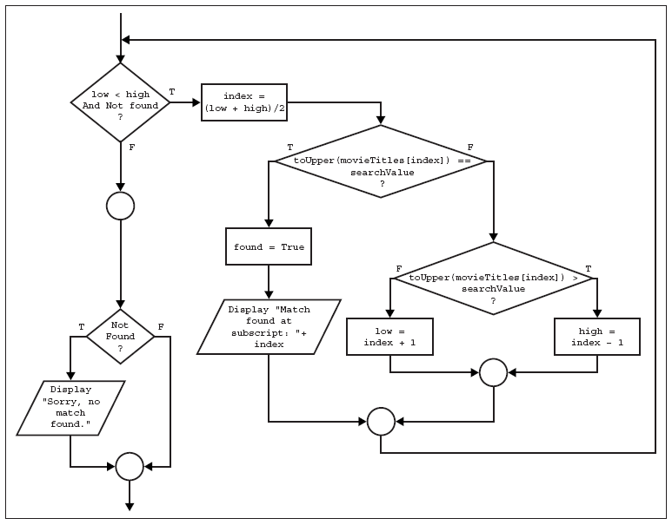
Figure 10-4 The flowchart for a binary search algorithm

Slide 28
Searching Arrays (cont’d.)
Project: determine how much more efficient binary search is than sequential search
  Change numberArray example to use binary search
  Determine number of comparisons
  Use guidelines on pages 390-391
  Solution on next slide

Slide 29
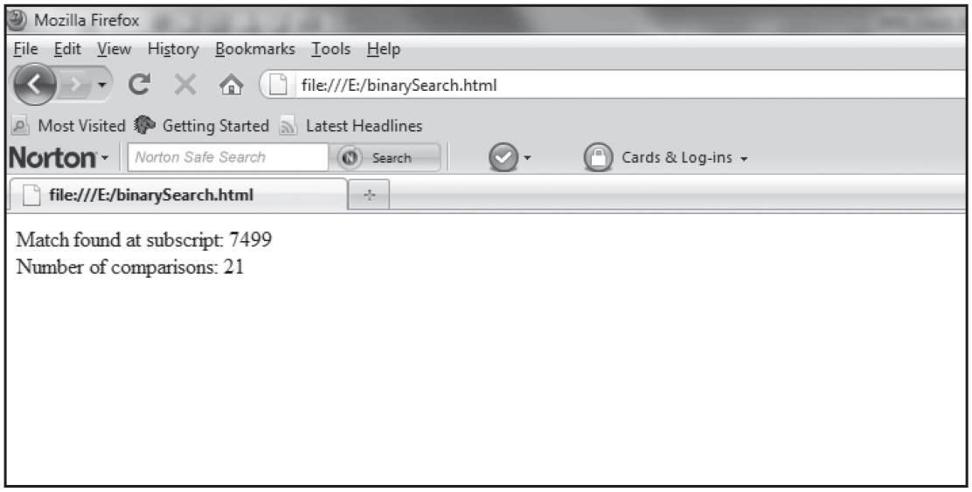
Searching Arrays (cont’d.)
Figure 10-5 The binarySearch.html program in a Web browser

Slide 30
Parallel Arrays
Array has a single name and data type
  Example: employee numbers
Can create parallel array
  To contain other employee information
  Use a common subscript to relate data fields
Example: arrays empNumber, empFirstName, and empLastName
empNumber[0]= employee number for Joe Smith
empFirstName[0] = “Joe”
empLastName[0] = “Smith”

Slide 31
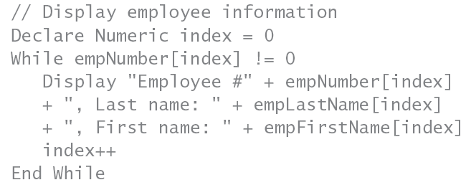
Parallel Arrays (cont’d.)
Example: display all employee information
  Works with nonzero employee numbers
  Example on next slide: search for employee information by last name

Slide 32
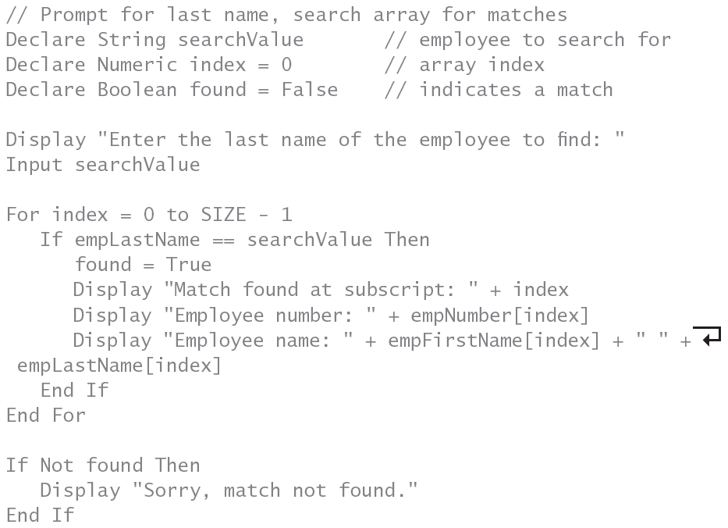

Slide 33
Multidimensional Arrays
Array can be thought of as list of variables
  One-dimensional array
Arrays can also have two, three, or more dimensions
  Two or more subscripts are used to identify elements
Two-dimensional array visualized as a grid
  Made up of rows and columns
  First subscript represents row
  Second subscript represents column

Slide 34
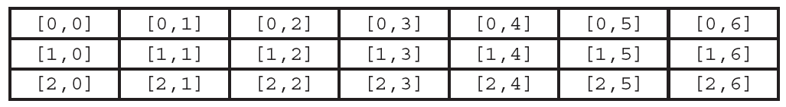
Multidimensional Arrays (cont’d.)
Example: array of daily temperatures for three weeks
Figure 10-6 Subscripts in a two-dimensional array

Slide 35
Multidimensional Arrays (cont’d.)
For loop
  Works well to traverse one-dimensional arrays
Nested For loops
  Ideal to traverse two-dimensional arrays
  Outer loop covers the rows
  Inner loop covers columns in each row
Example on next slide

Slide 36
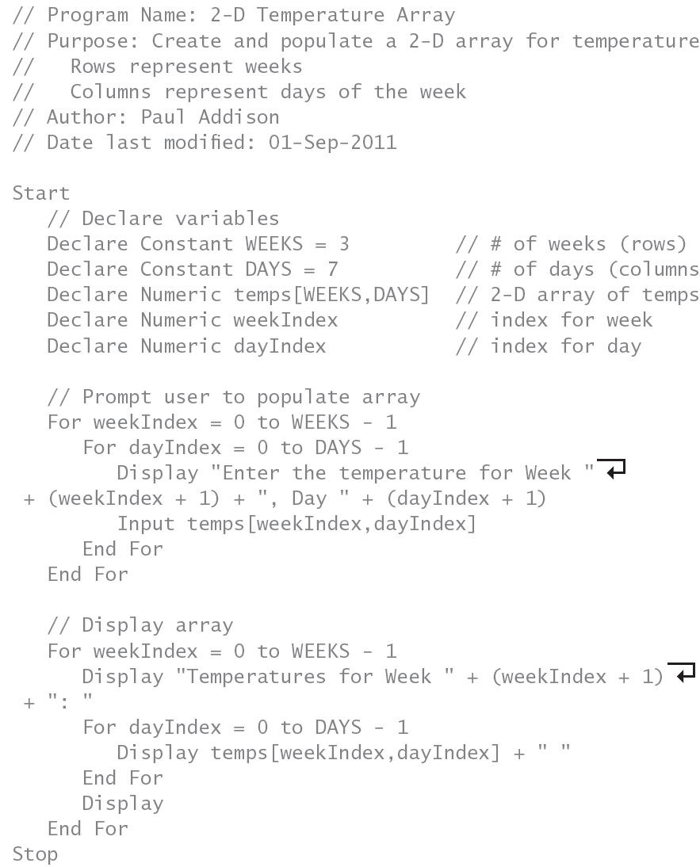

Slide 37
Multidimensional Arrays (cont’d.)
Two-dimensional arrays in JavaScript
  Each array element contains array of its own
  Use separate brackets for each subscript
To assign values:
  Create one-dimensional array
  Add a for loop that sets each array element to an array of its own

Slide 38
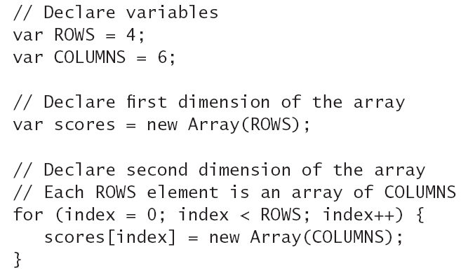
Multidimensional Arrays (cont’d.)
Example: golf scores for four people and six games

Slide 39
Multidimensional Arrays (cont’d.)
Project: convert temps array to JavaScript array
  Rows represent weeks
  Columns represent days of the week
Solution output on next slide

Slide 40
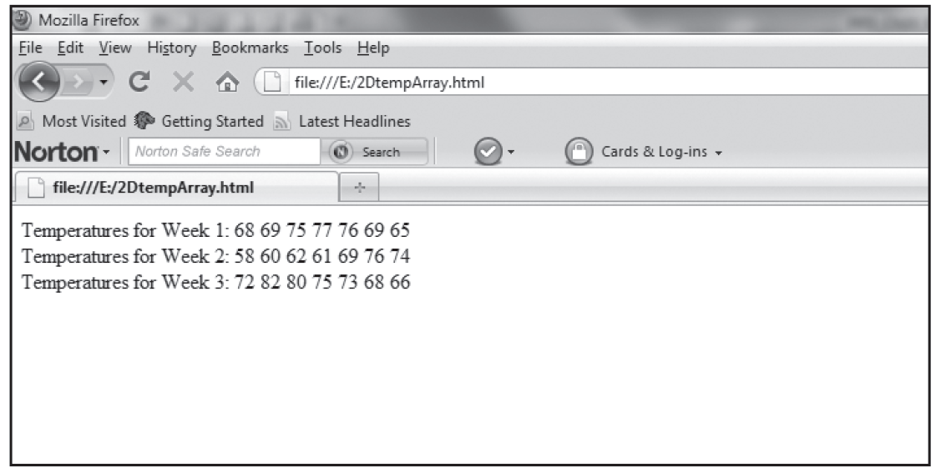
Multidimensional Arrays (cont’d.)
Figure 10-7 The 2DtempArray.html program in a Web browser

Slide 41
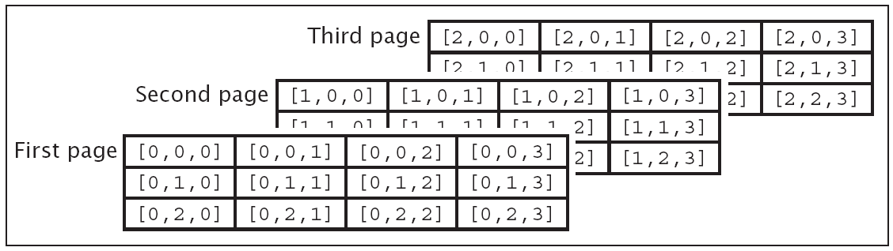
Multidimensional Arrays (cont’d.)
Arrays of three dimensions or more
  Three-dimensional array
    Like workbook containing multiple spreadsheet pages
    Each page is a grid of rows and columns
    Need three subscripts to reference data
Figure 10-8 A three-dimensional array

Slide 42
Multidimensional Arrays (cont’d.)
Arrays of more than three dimensions
  Difficult to visualize
  Subscripts represent levels of organization
  Understand what each subscript represents
Example of four-dimensional array cityPopulation
  Subscript indicates region, state, county, and city;
    cityPopulation[0,0,0,1] is reference to population in Ritzville

Slide 43
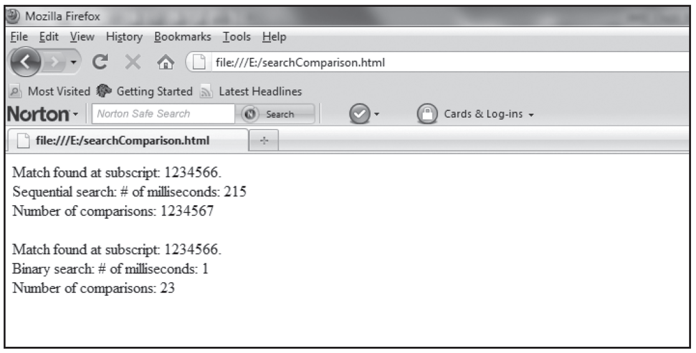
Multidimensional Arrays (cont’d.)
Complete Programmer’s Workshop on pages 398-403
Figure 10-9 The searchComparison.html program in a Web browser

Slide 44
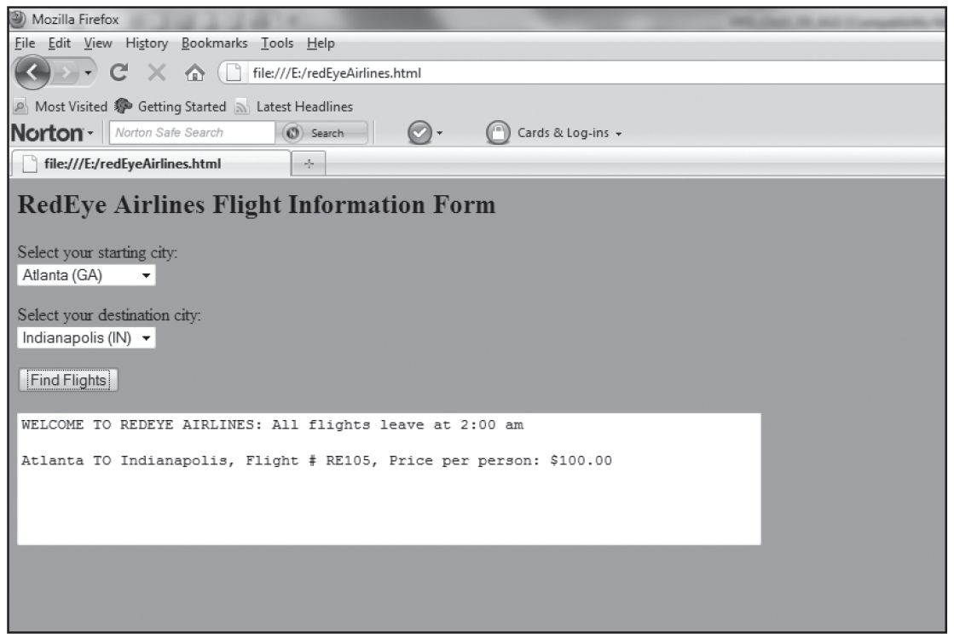
Multidimensional Arrays (cont’d.)
Complete Object Lesson on pages 404-409
Figure 10-11 The redEyeAirlines.html program in a Web browser

Slide 45
Summary
Array: collection of related variables
  Same name and data type
  Distinguished by a subscript
Array subscripts begin with zero
Arrays can be traversed using For loops
  Index serves as array subscript
Arrays can be loaded directly or interactively
  Can load in the declaration statement
JavaScript arrays created with keyword new

Slide 46
Summary (cont’d.)
Increment and decrement operators += and -=
  Shortcut notation for adding or subtracting values
Searching arrays
  Sequential search
    Terminate search after match is found
  Binary search
    More efficient
Parallel arrays are related with common subscript
Multidimensional arrays use two or more subscripts

